Slide 1

XML Data
DTDs,
IDs & IDREFs

Slide 2
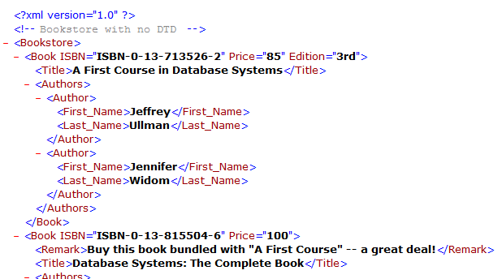
DTDs, IDs & IDREFs
“Well-Formed” XML
Adheres to basic structural requirements
Single root element
Matched tags, proper nesting
Unique attributes within elements

Slide 3
DTDs, IDs & IDREFs
“Valid” XML
Adheres to basic structural requirements
Also adheres to content-specific specification
Document Type Descriptor (DTD)
XML Schema (XSD)

Slide 4
DTDs, IDs & IDREFs
“Valid” XML
Adheres to basic structural requirements
Also adheres to content-specific specification
XML
Document
XML
Parser
Parsed XML
“Not well-formed”

Slide 5
DTDs, IDs & IDREFs
“Valid” XML
Adheres to basic structural requirements
Also adheres to content-specific specification
DTD or XSD
XML
Document
Validating XML
Parser
“Not well-formed”

Slide 6
DTDs, IDs & IDREFs
“Valid” XML
Adheres to basic structural requirements
Also adheres to content-specific specification
DTD or XSD
XML
Document
Validating XML
Parser
Parsed XML
“Not valid”

Slide 7
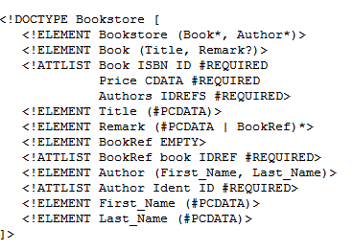
DTDs, IDs & IDREFs
Document Type Descriptor (DTD)
Grammar-like language for specifying elements,
attributes, nesting, ordering, #occurrences
Also special attribute types ID and IDREF(S)

Slide 8
DTDs, IDs & IDREFs
DTD/XSD versus none (well-formed)
+ DTD/XSD
- DTD/XSD

